Slide 1



Unveiling Fan Bias in NCAA Bracket Predictions:
Trends, Accuracy, and the Impact of School Affinity
MARCH MADNESS
Team: Win and Retired
Huangkun Chen
Yingtong Wang
Nikhil Ram Atluri
Yingjie Chen
2025.2

Slide 2
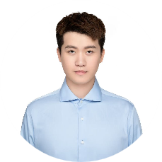



TEAM ROLES & CONTRIBUTIONS
Huangkun Chen
Yingtong Wang
Yingjie Chen
Nikhil Ram Atluri
Leader
Presentation
Tableau Analysis
Kaggle Submission
Presentation
Tableau Analysis
Kaggle Submission
Task Allocation
Tableau Analysis
Communication
Tableau Analysis
Kaggle Submission
Email
Email
Email
Email
chen5180@purdue.edu
wang6679@purdue.edu
chen5301@purdue.edu
atlurin@purdue.edu
We are all Purdue Univeristy MSBAIMer !

Slide 3
CCAC
TABLE OF CONTENTS
PART 1
Introduction & Problem Framing
PART 4
Key Findings & Insights
Problem Statement
Trend Analysis
Key Assumptions
Bias Detection (School affinity)
Success Metrics
Prediction vs. Reality
Data & Feature Engineering
Home Advantage Impact
PART 2
PART 5
Conclusion & Future Work
Data Source
Data Preprocessing
Key Takeaways
Data Relationships
Future Work
Predictive Modeling & Analysis
APPENDIX
PART 3
Predictive Modeling Approach
Team Contributions
Model Performance
Acknowledgments

Slide 4

CCAC
PART 1
Introduction & Problem Framing
Problem Statement
Key Assumptions
Success Metrics

Slide 5
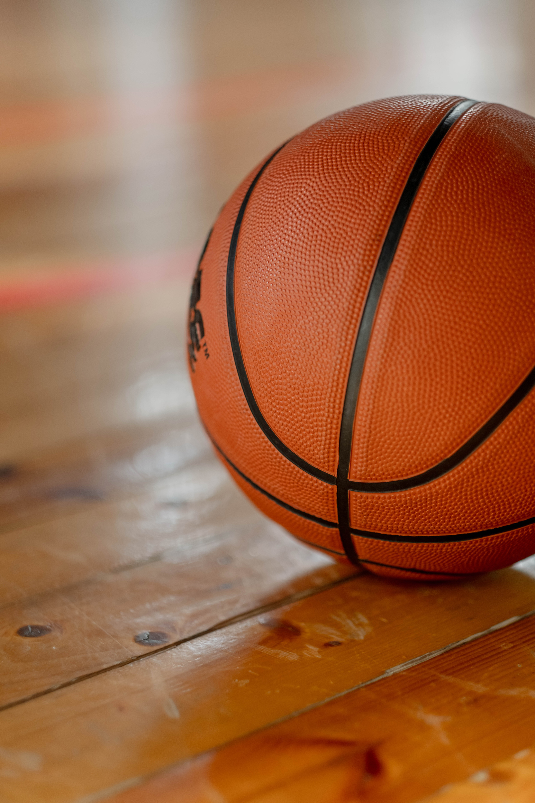

CCAC
PROBLEM STATEMENT
“ Our goal is to develop a predictive model based on fan-submitted bracket data to forecast the winners of the NCAA semifinals and national championship. Beyond that, we aim to analyze whether school affinity influences fan predictions—specifically, whether fans are more likely to support certain teams based on geographic proximity or historical loyalty. ”

Slide 6
ADDITIONAL ANALYTICS
Do prediction trends change over time?
(Macro-level trend)
↓
Is there significant fan bias in predictions?
(Core factor driving prediction behavior)
↓
Do fan predictions accurately reflect a team’s actual competitive strength?
（Impact of prediction bias)
↓
Does home vs. away performance further influence fan predictions?
(Additional external factor)

Slide 7
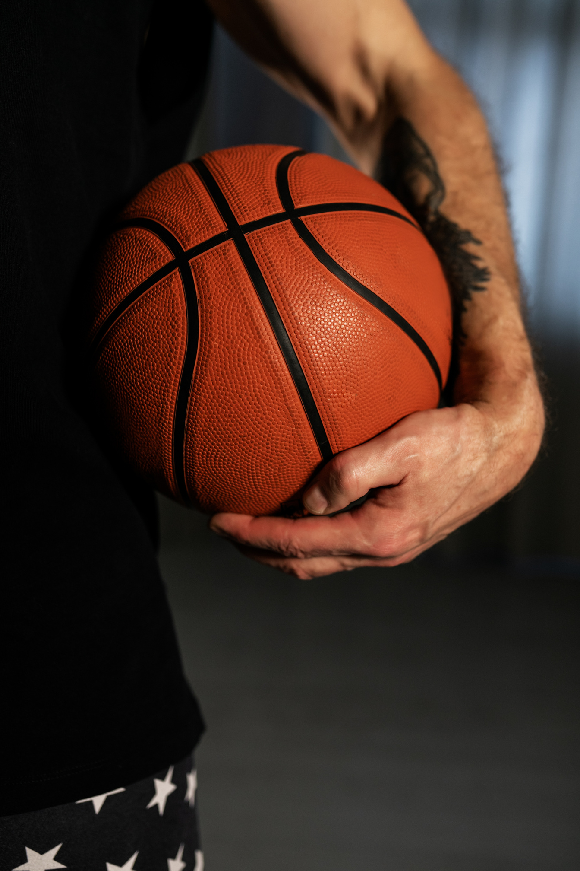
Home
KEY ASSUMPTIONS
DATA ASSUMPTIONS
Fan-submitted brackets accurately represent real prediction behavior.
The selected features sufficiently describe fan prediction patterns.
Data distributions remain consistent between training and testing sets.
Each fan’s prediction is independent of others.
MODELING ASSUMPTIONS
XGBoost are suitable for this classification task.
Feature engineering improves predictive performance.
The model is robust to overfitting.
AUC-ROC is appropriate evaluation metrics.

Slide 8
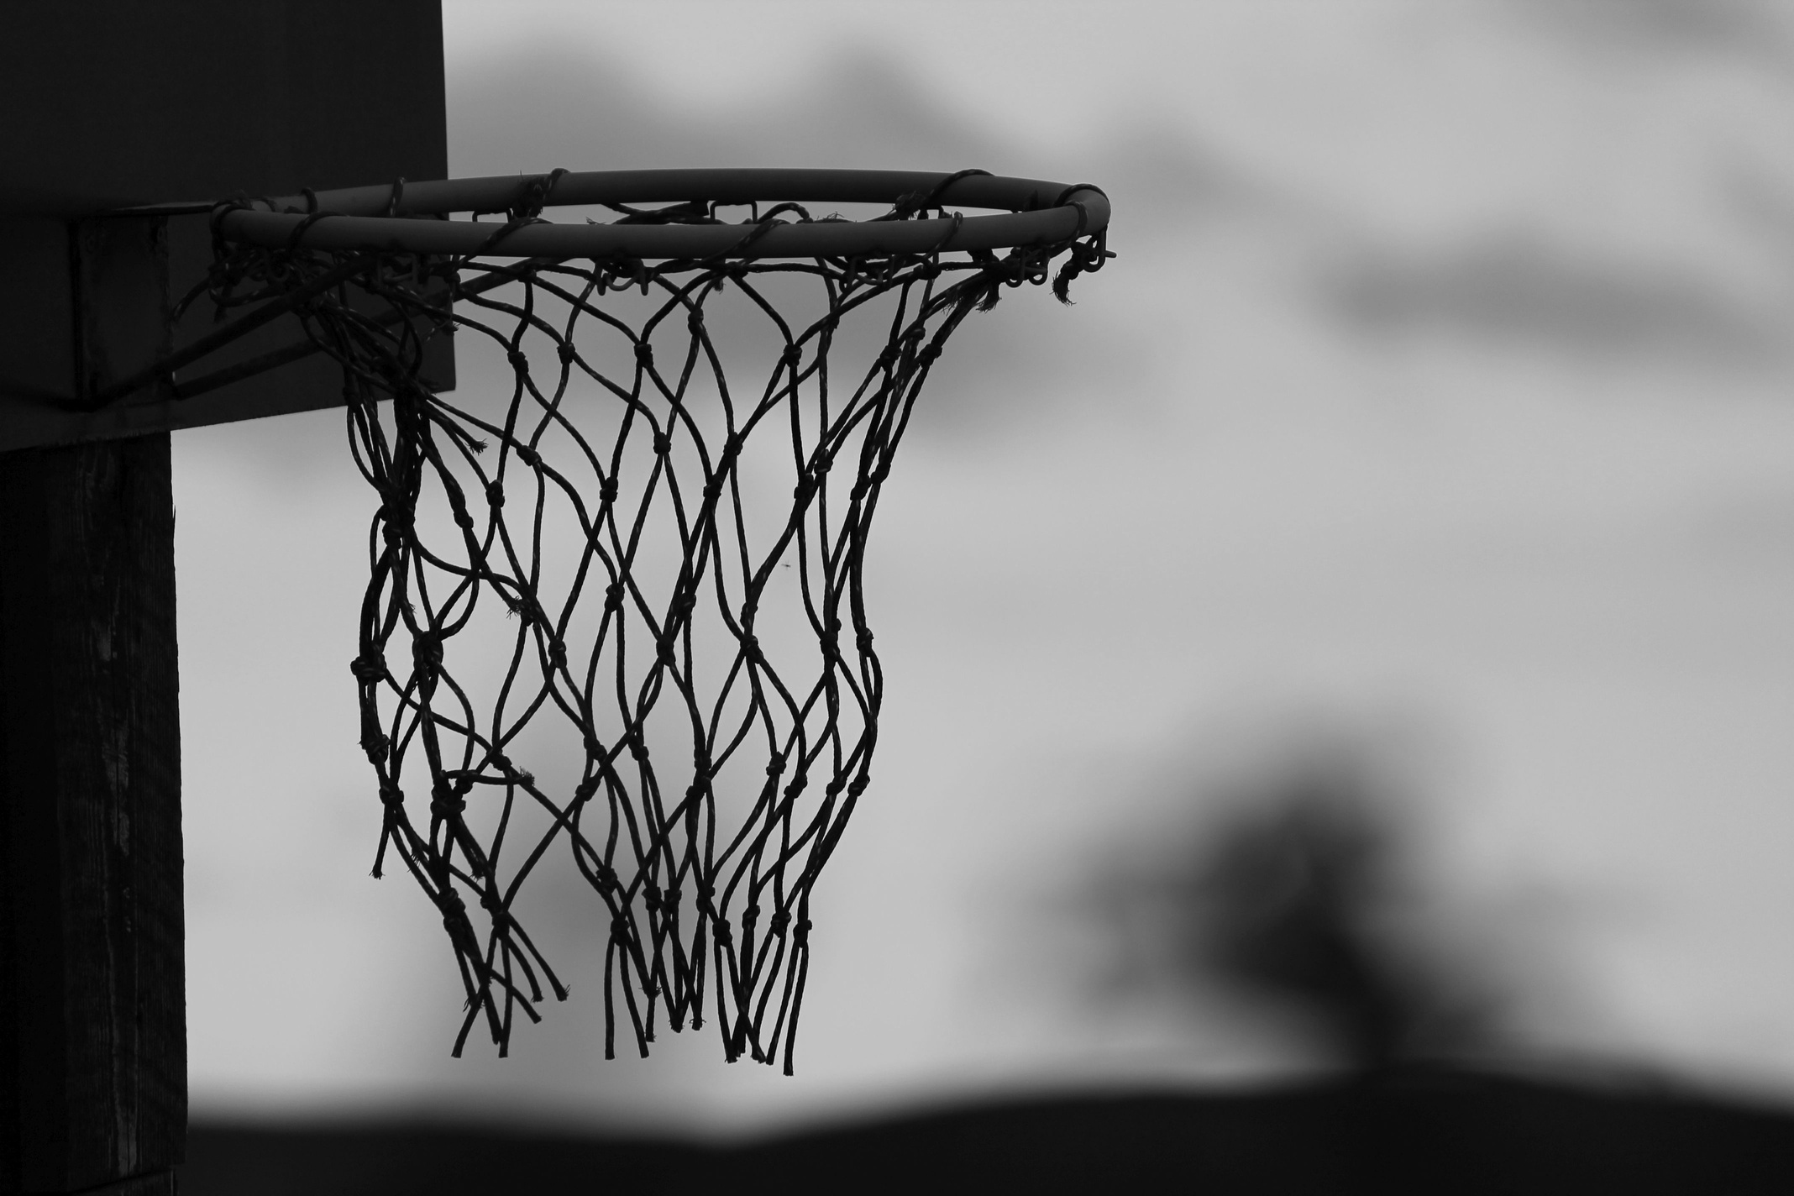
SUCCESS METRICS
1. Predictive Model Performance Metrics (Evaluating Model Accuracy)
✅ Accuracy – Measures the percentage of correct predictions. Higher accuracy indicates better model performance.
2. Fan Behavior & Bias Quantification Metrics (Evaluating Insights on Fan Predictions)
✅ Bias Score – Quantifies fan bias toward certain teams (e.g., overestimating popular teams).
✅ Prediction Deviation – Compares fan predictions vs. actual game results, revealing overestimated/underestimated teams.
✅ Regional Influence – Measures how geographic factors (DMA, clustering) impact fan predictions.

Slide 9
CCAC
PART 2
Data & Feature Engineering
Data Source
Data Preprocessing
Data Relationships

Slide 10
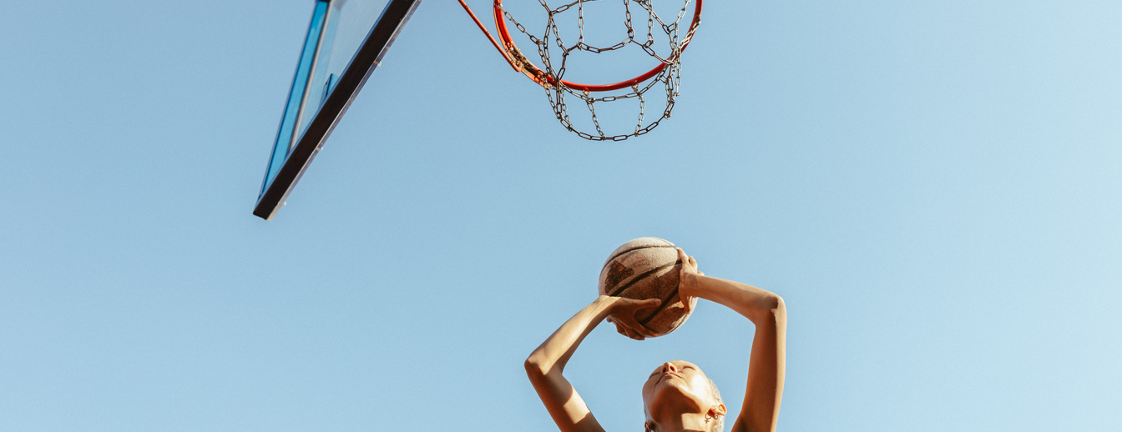
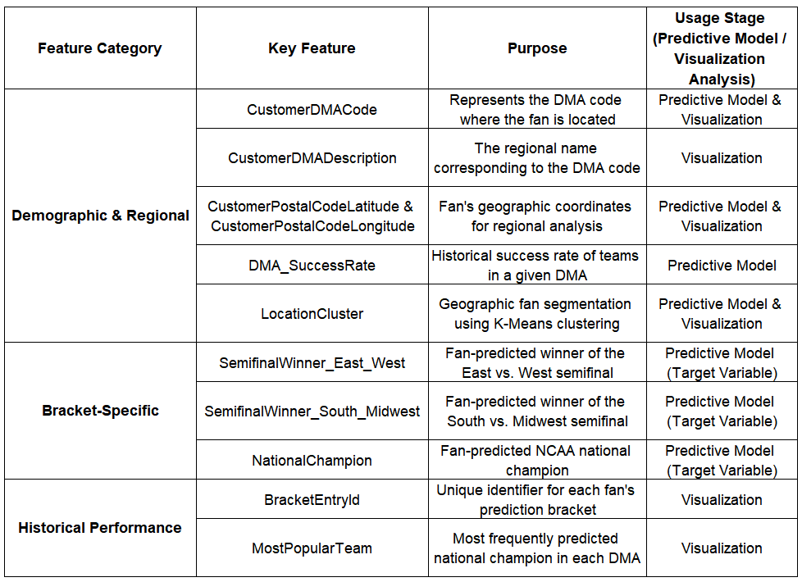
DATA SOURCES
Key Features
Training Set (bracket_train.csv)
Test Set (bracket_test.csv).
Submission Template (submission_template.csv)
CCAC 2025 - Institutions.csv
A list of schools and their associated school IDs.
Can be used for feature engineering, such as team strength, historical performance, or conference affiliations.
CCAC 2025 - Data Dictionary.xlsx
Provides detailed descriptions of each column in the dataset.
Essential for understanding feature meanings and ensuring accurate data preprocessing.
Division I Women_s Basketball Contests.csv

Slide 11
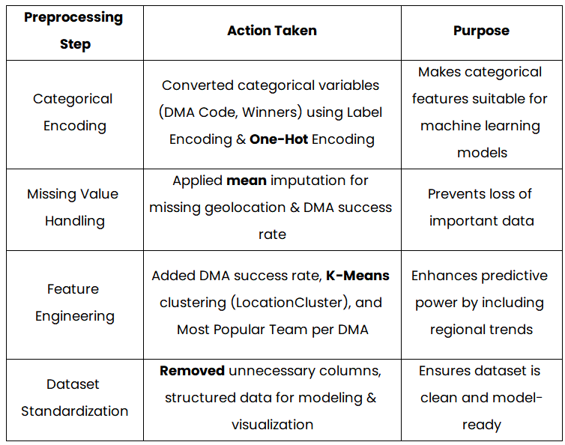
DATA PREPROCESSING

Slide 12
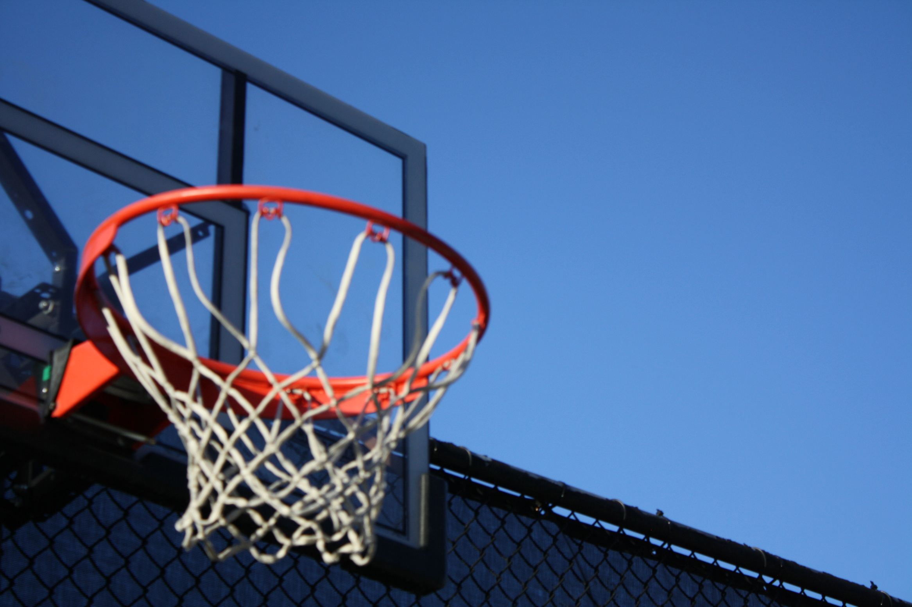

DATA RELATIONSHIPS
The Training dataset contains Region Winners, Semifinal Winners, and National Champion as Institution IDs, which can be linked to the Institution dataset (CCAC 2025 - Institutions.csv) to retrieve school names and additional attributes such as conference affiliation and historical performance. Additionally, the DMA information in the Training dataset can be matched with the Customer DMA dataset, providing insights into regional fan preferences. The Submission template ensures that predictions align with the required format, and the Data Dictionary helps in understanding feature definitions for accurate preprocessing and modeling.

Slide 13
CCAC
PART 3
Predictive Modeling & Analysis
Predictive Modeling Approach
Model Performance

Slide 14

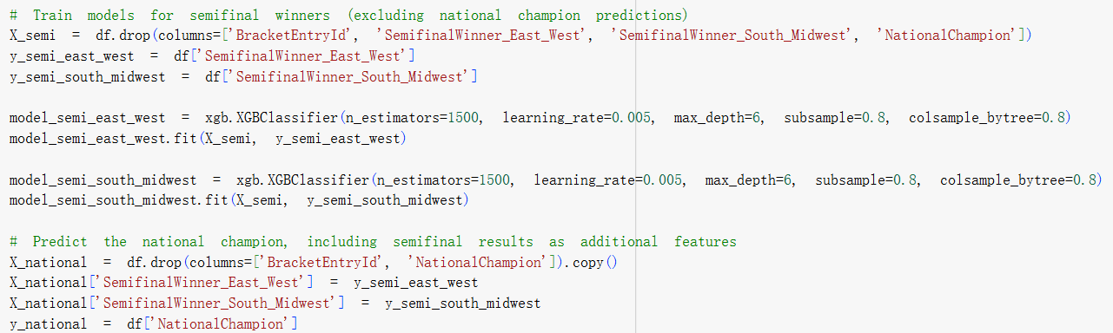
PREDICTIVE MODELING APPROACH

Slide 15

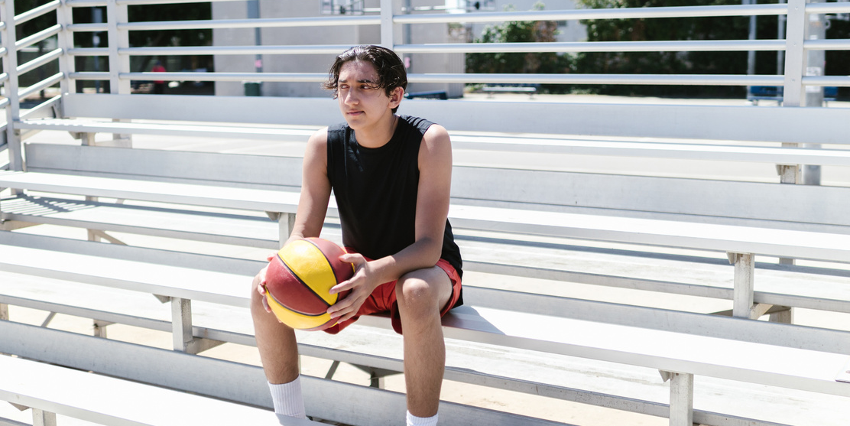
MODEL PERFORMANCE
{'Semifinal East-West': {'Accuracy': 0.6895119418483905},
'Semifinal South-Midwest': {'Accuracy': 0.6432444905965156},
'Final National Champion': {'Accuracy': 0.4696357832391062}}

Slide 16
CCAC
PART 4
Key Findings & Insights
Do prediction trends change over time?
Is there significant fan bias in predictions?
Do fan predictions reflect actual team performance?
Does home vs. away performance affect predictions?

Slide 17
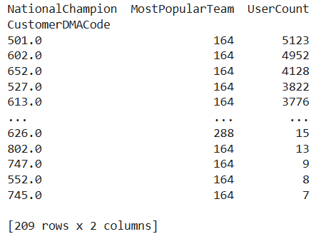
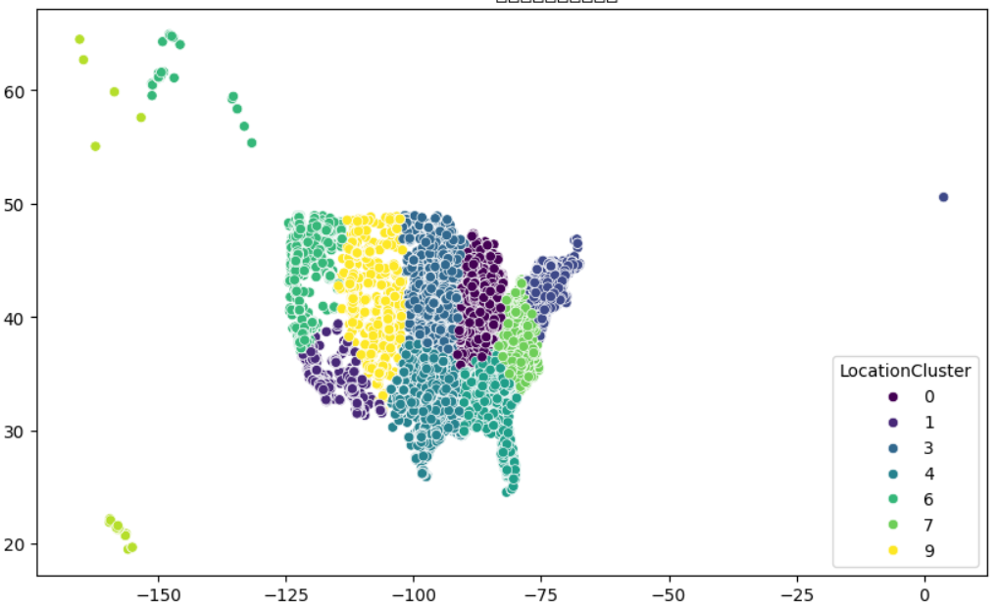
GEOSPATIAL CLUSTERING
& REGIONAL VOTING TRENDS
IN FAN PREDICTIONS
K-MEANS CLUSTERING ANALYSIS OF CUSTOMER GEOGRAPHIC DISTRIBUTION
📌 1. Processing CustomerDMACode (DMA Code)
Converted to a categorical variable
Calculated historical success rate for each DMA
Split CustomerDMADescription column and One-Hot Encoding
📌 2. Processing Geographic Information (Latitude & Longitude)
Converted to numeric format
Used mean imputation handling missing values
📌 3. K-Means Clustering Analysis of Geographic Distribution
Applied K-Means clustering to group customers by location
Visualized clustering results
📌 4. Analyzing Voting Trends by DMA Code
Computed voting distribution by DMA code
Identified the most popular team in each DMA
Counted the number of users per DMA
Latitude
Longitude

Slide 18
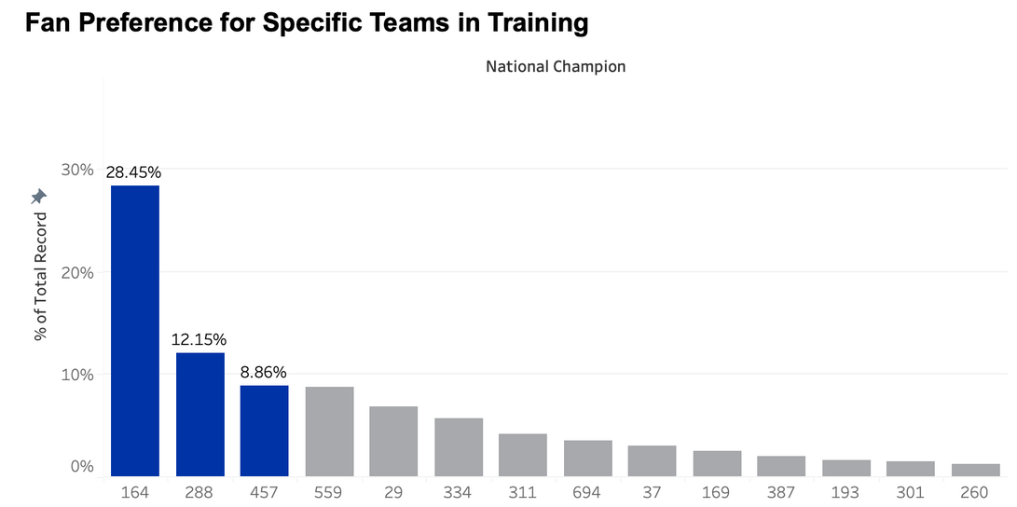
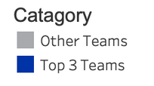
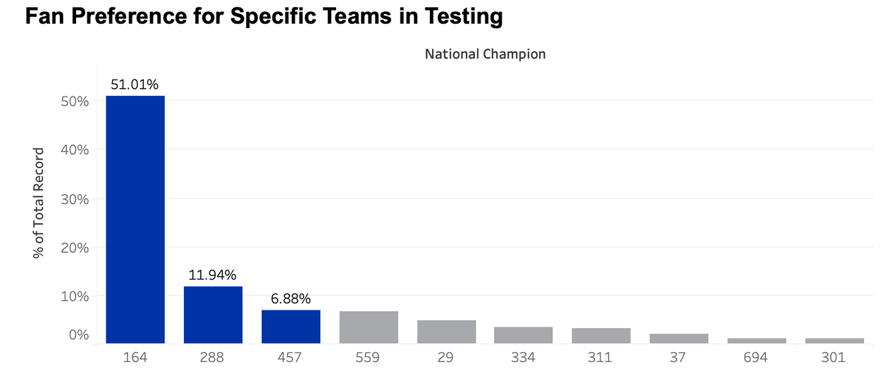
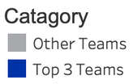
FAN PREFERENCE
“ The chart presents fan prediction data (Training) and model-simulated fan prediction data (Testing) for the D-I Man Basketball National Champion.
The model successfully replicates the overall trend of fan preferences in terms of proportions. “
“ For example, Team 164 holds the highest percentage in both datasets, and the top five teams remain consistent across both sets.
This indicates that the model effectively captures fan preference patterns. “

Slide 19
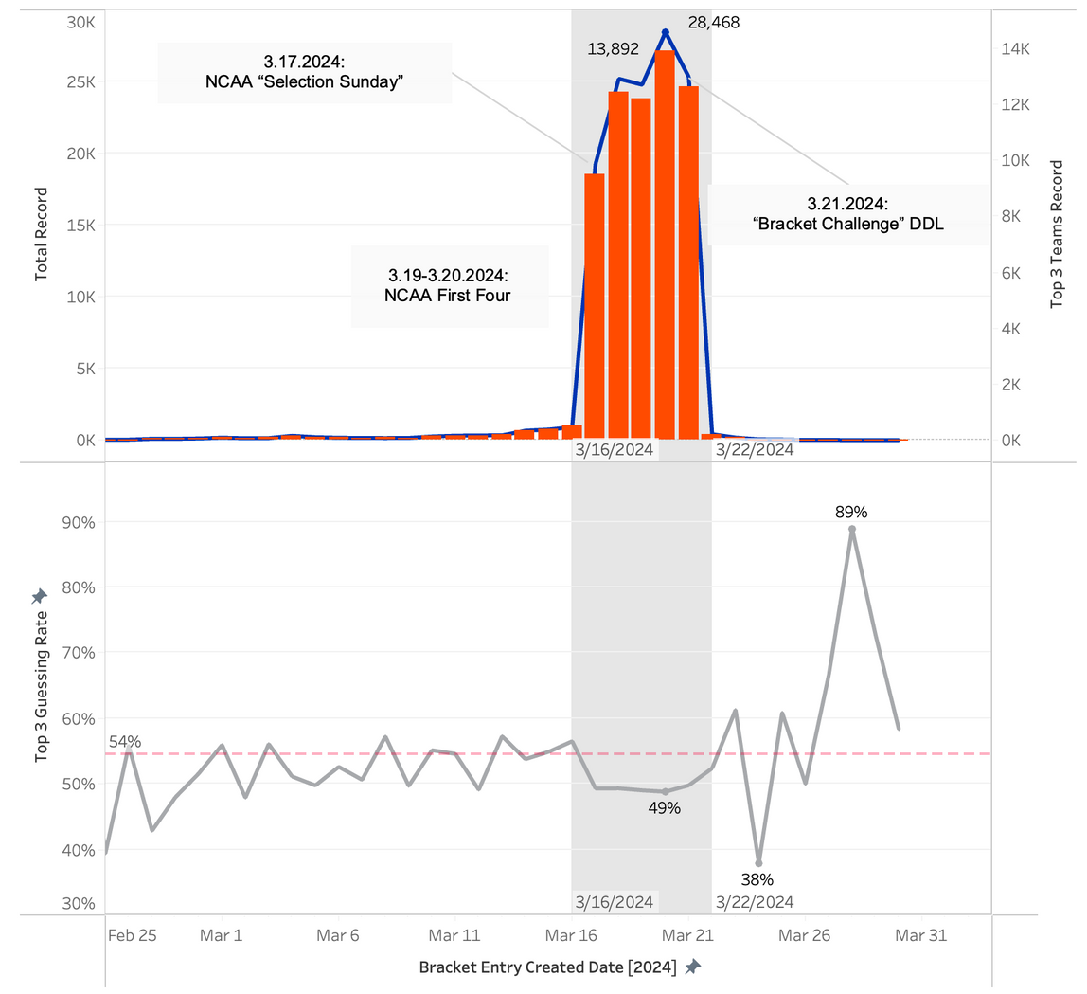

THE TREND IN FAN PREDICTIONS OVER TIME
📈 March 16-21, 2024: Fan predictions surged to a peak, driven by three key events.
🔄 Peak Period Trend: The proportion of predictions for the top three teams declined, indicating fans explored more diversified strategies before the deadline.
🎯 Post-Deadline (After March 22): Predictions became more concentrated on the top three teams, likely influenced by actual game results or media coverage.

Slide 20
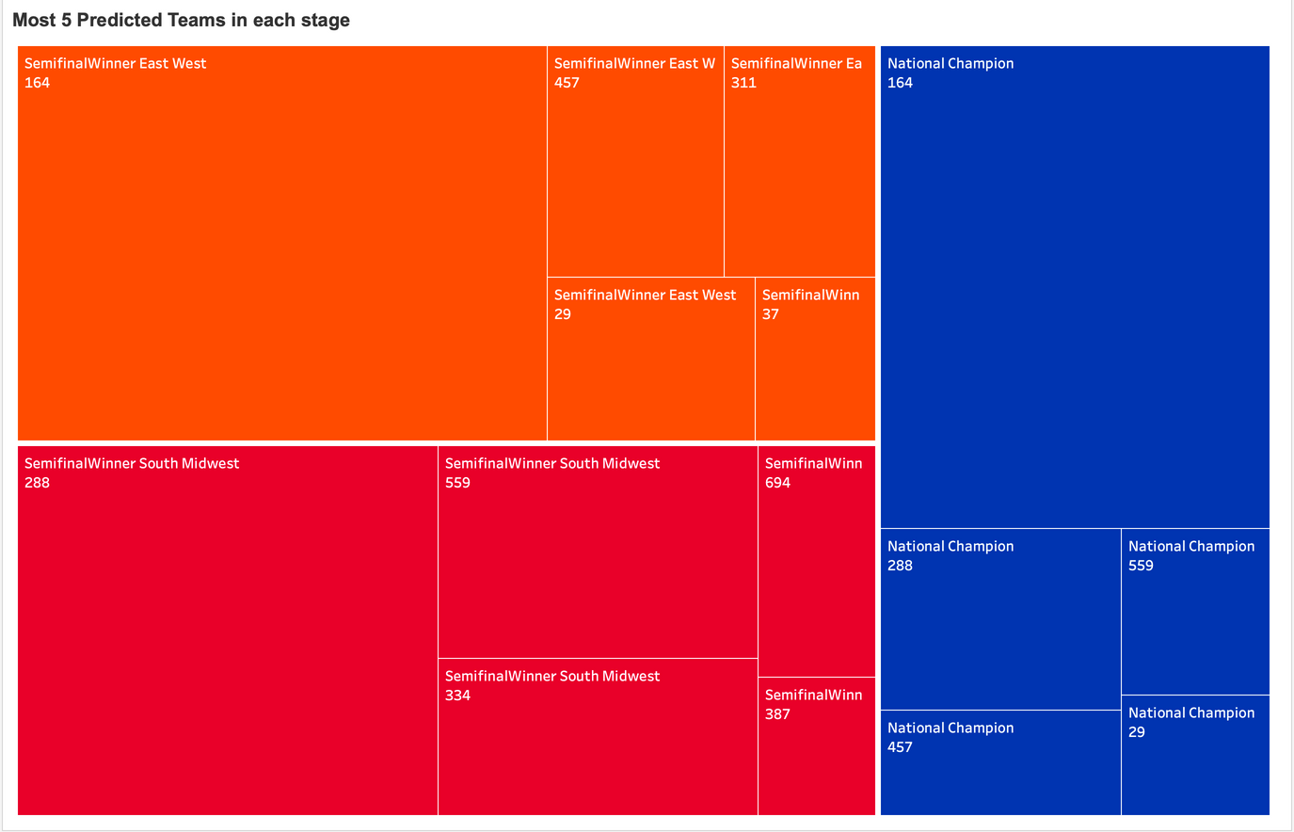
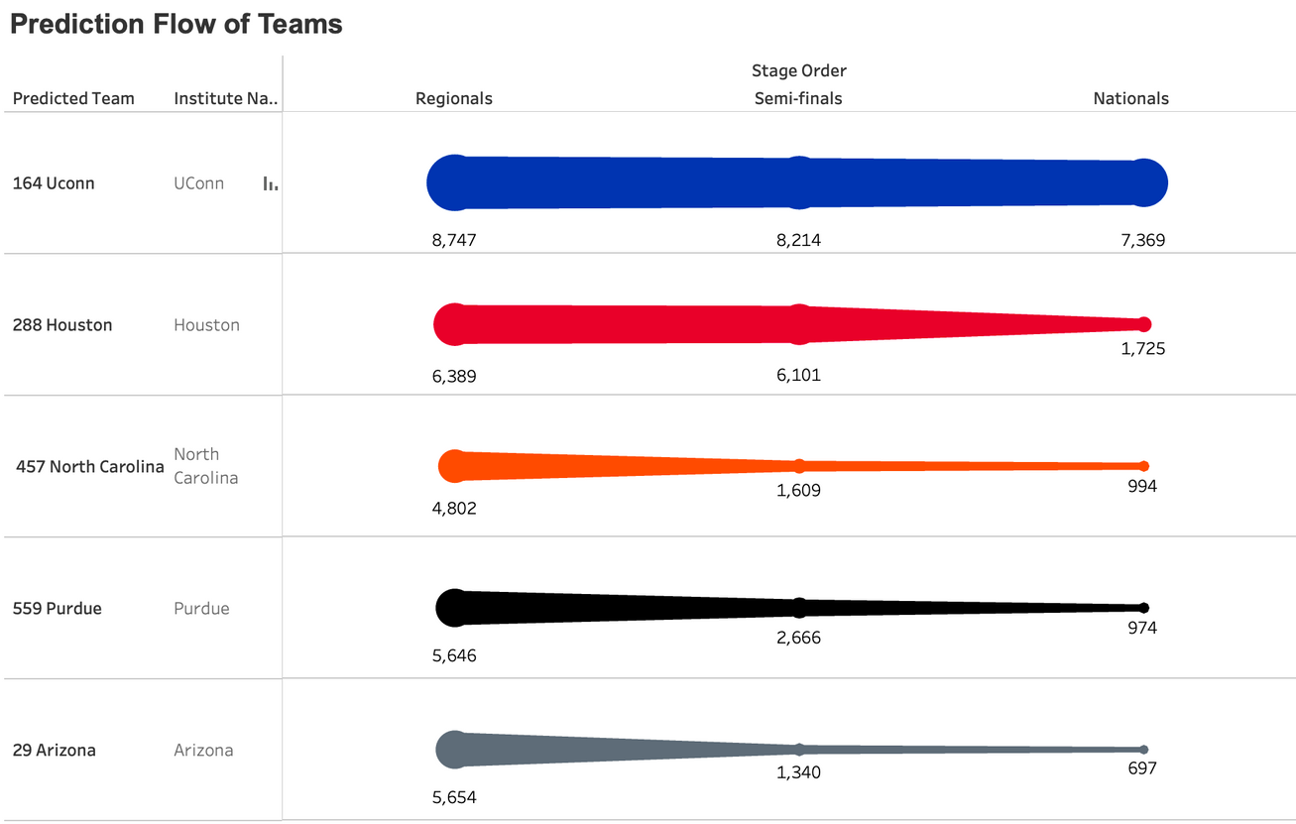
MOST 5 PREDICTED TEAMS
✔ UConn is the most popular prediction among fans, with a relatively stable support rate across all stages.
✔ Houston and North Carolina experienced a significant decline in prediction support as they progressed, possibly influenced by actual game results, team performance, or external factors such as injuries and schedule difficulty.

Slide 21
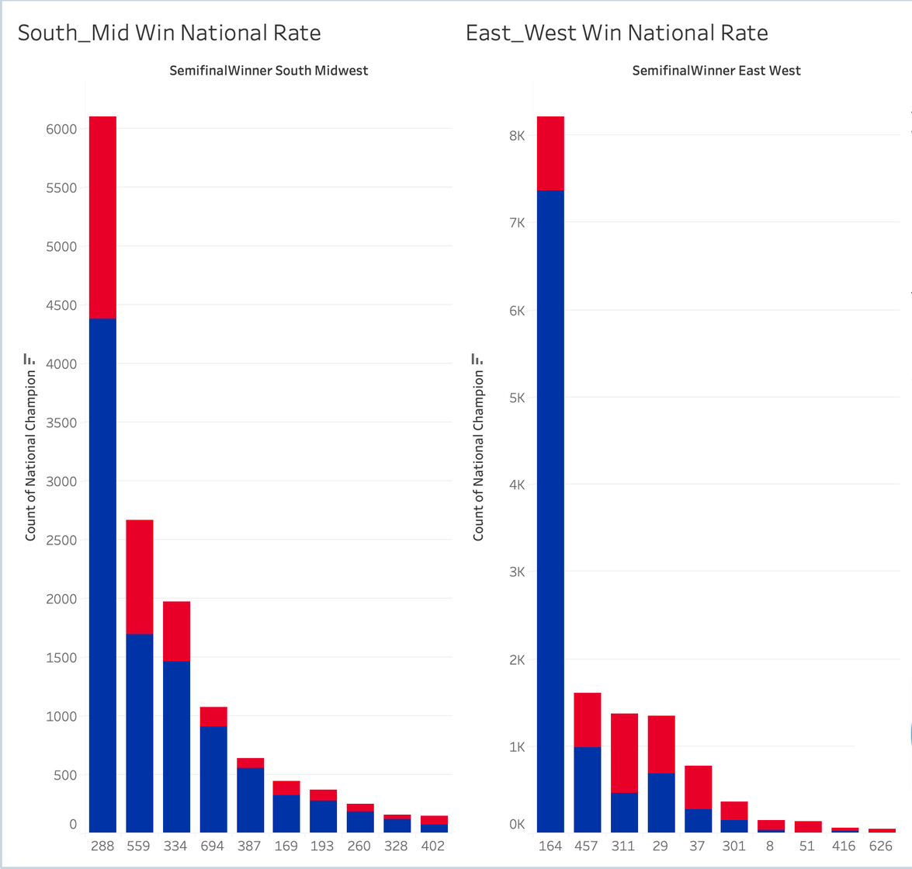

COMPARING NATIONAL CHAMPIONSHIP WIN RATES:
✔ UConn (164) and Houston (288) are the top favorites in their respective regions, having the highest number of national championships.
✔ Teams 559 and 334 from the South Midwest region, as well as Teams 457 and 311 from the East West region, also demonstrate strong championship competitiveness.

Slide 22
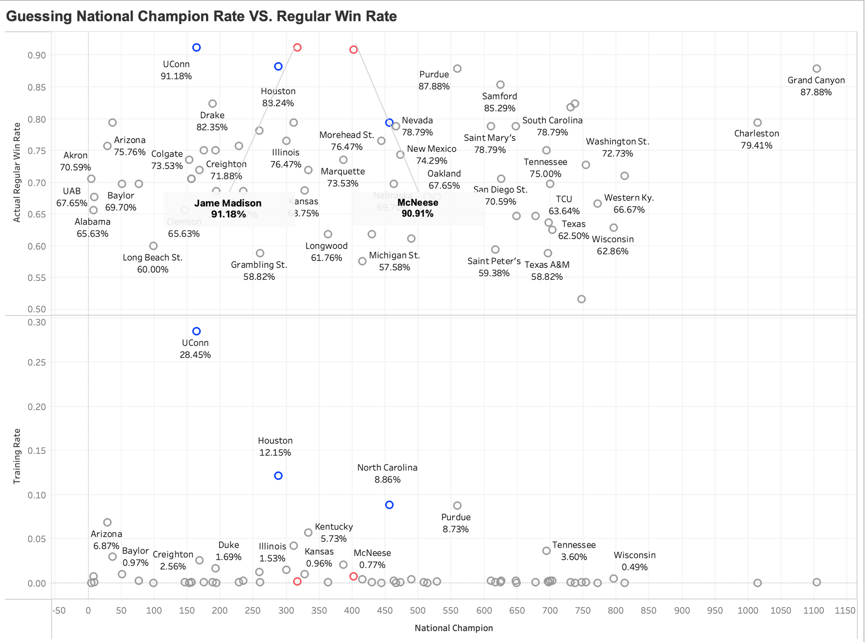
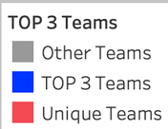
GUESSING NATIONAL CHAMPION RATE VS. REGULAR WIN RATE
✔ Fan prediction preferences do not always align with actual win rates, indicating that predictions may be influenced by Team effect, historical performance, and emotional bias.
✔ Some high-win-rate teams, such as James Madison and McNeese, are significantly underrated and may deserve more attention.

Slide 23
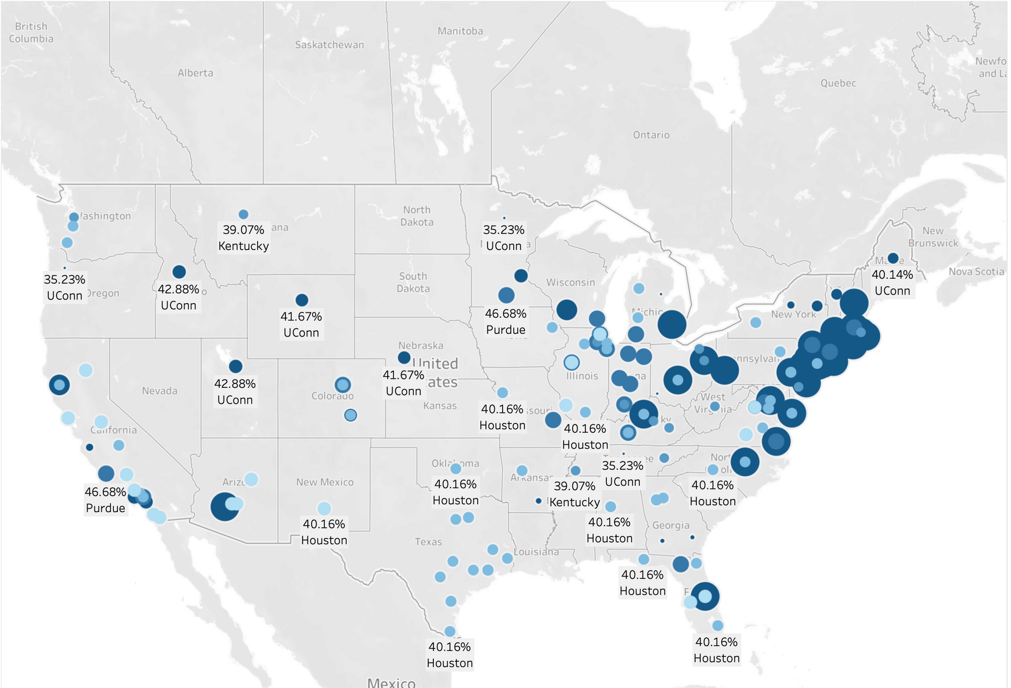
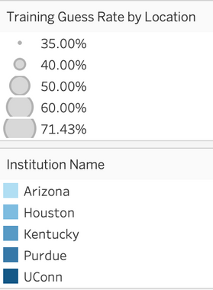
HOMETOWN BIAS OR TRUE CONTENDERS?
📍 Geospatial Visualization:
• Shows fan support distribution across U.S. regions.
• Bubble size = prediction rate.
🔍 Key Insights:
• Regional Bias: Fans favor local teams (e.g., Houston 40.16% in Texas, UConn 42.88% in Northeast).
• Varied Preferences: Some states show strong local loyalty, others more diverse guesses.
• Overestimation: Teams like Purdue (46.66%) in the Midwest may be overrated due to hometown bias.

Slide 24
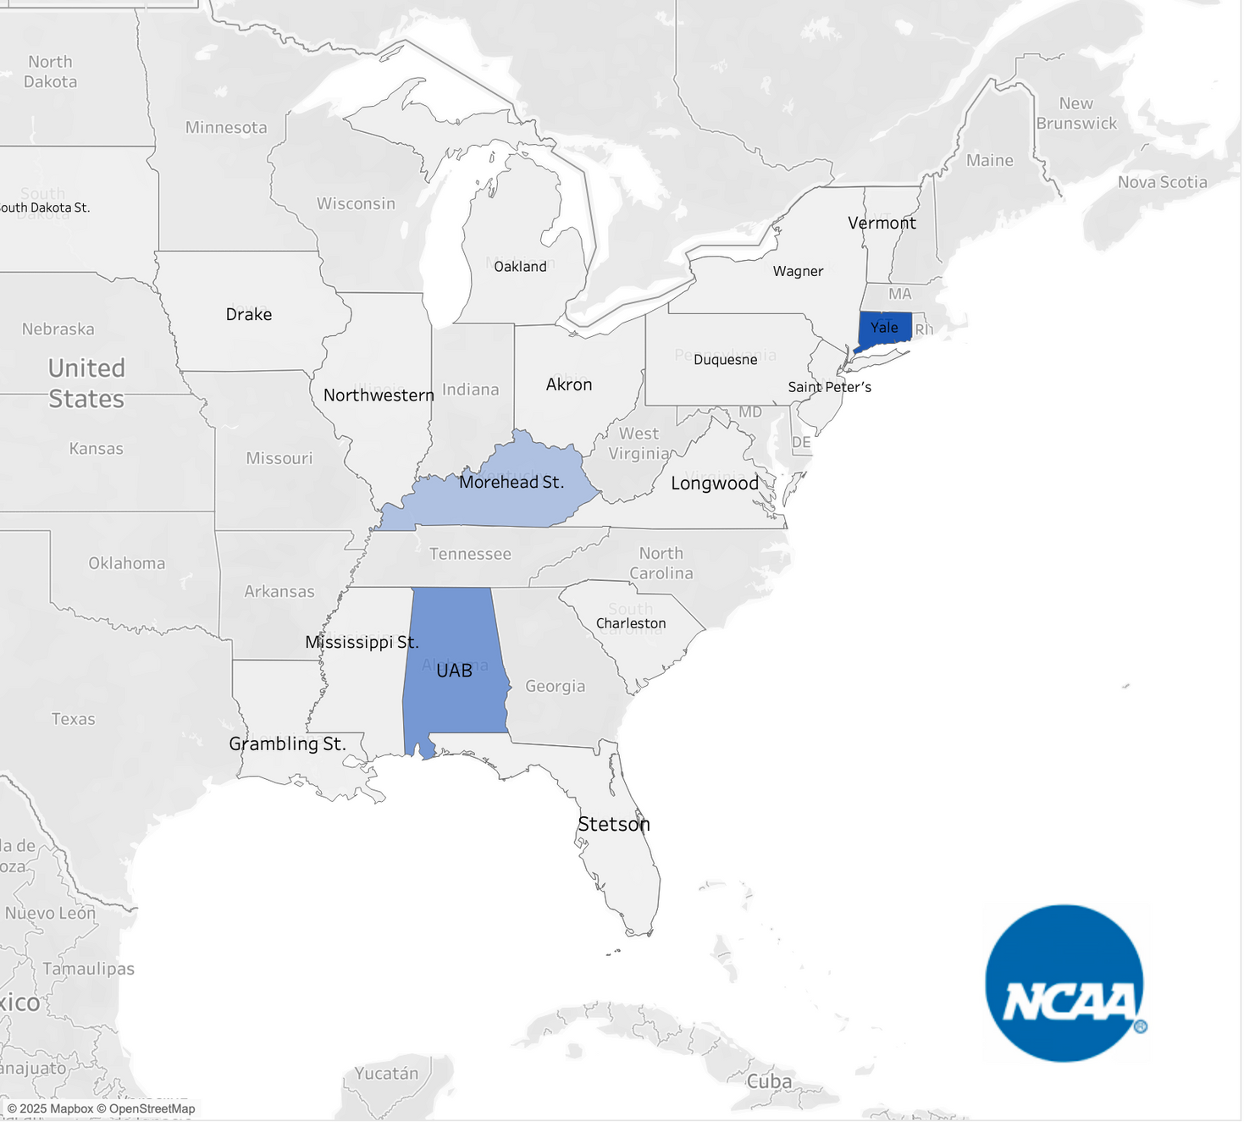
REGIONAL BIAS
Favouritism of Predicted Team in Home State vs All States
√ Higher Bias in Some States: States like Connecticut (Yale), Kentucky (Morehead St.), and Mississippi (Mississippi St.) show strong home-state favoritism, as seen by their darker shades.
√ Small Schools Can Have High Bias: Despite not being traditional powerhouses, teams like Morehead St. and Saint Peter’s have high local support, suggesting school loyalty influences predictions more than objective rankings.
√ Potential School Affinity Effect: The darker the shade, the stronger the local prediction bias, suggesting that users tend to pick teams from their own state regardless of team strength.

Slide 25
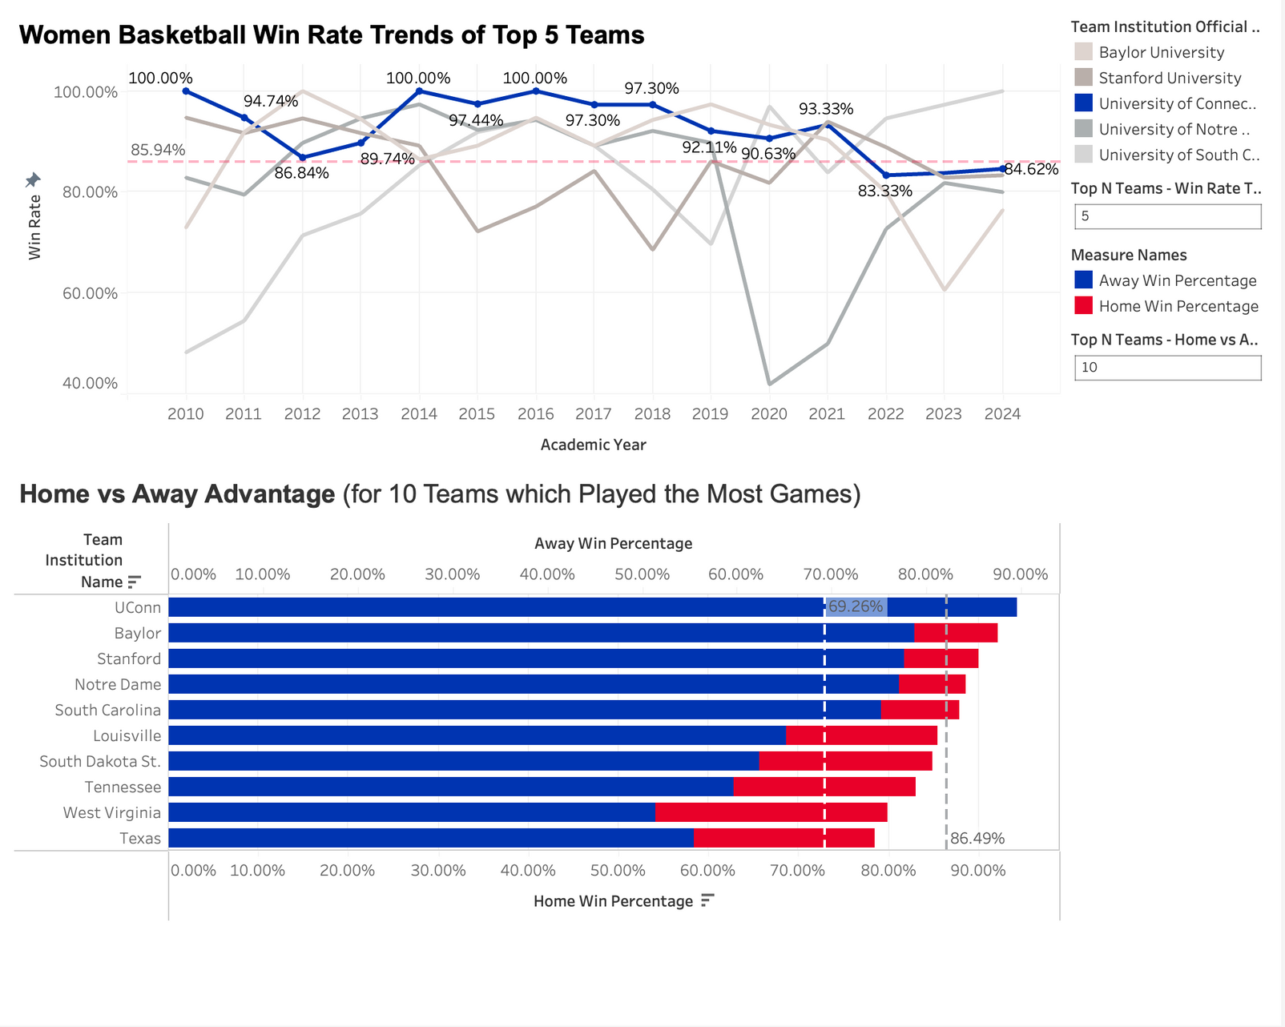
DOES WOMEN’S BASKETBALL POPULARITY INFLUENCE MEN’S BASKETBALL SUPPORT?
Strong Women’s Basketball Programs → Loyal Fanbase
UConn, Stanford, and South Carolina show consistently high win rates & strong fan engagement.
Possible Link Between Women’s & Men’s Support
Universities with dominant women’s teams often have well-recognized men’s programs, suggesting a potential crossover effect.
Regional & Historical Influence
Fan support may extend across genders due to school-wide sports culture and local loyalty.

Slide 26
CCAC
PART 5
Conclusion & Future Work
Key Takeaways
Future Work

Slide 27
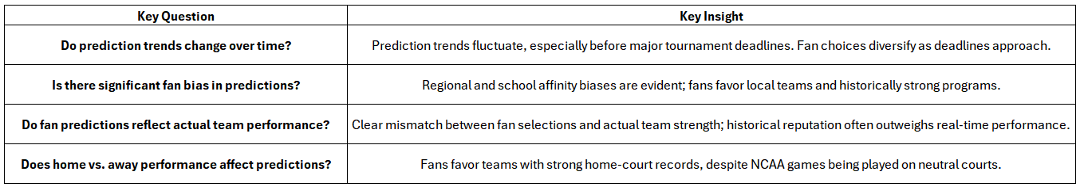
KEY TAKEAWAYS
Home
1️⃣ Predictive Model Performance
📌 Kaggle Leaderboard Performance
Our model achieved a Kaggle score of 0.63051.
2️⃣ School Affinity & Fan Bias Findings
📌 Key Observations on Fan Loyalty & Bias
Fans exhibit strong school affinity, favoring local teams over objectively stronger competitors.
Regional clustering reveals distinct voting biases—certain states heavily support their home institutions, even when their teams are underdogs.
Historical school performance influences both men’s and women’s basketball predictions, reinforcing the idea that fans are loyal to the school, not just a specific team.
3️⃣ Additional Analytical Findings (Part 4 Insights & Extended Analysis)
📌 Exploring Trends in Fan Predictions

Slide 28
FUTURE WORK
🔹 Address Data Bias in Predictions
If fans over-support popular teams, the model may reinforce this bias, reducing accuracy in identifying underdog victories.
Future improvements should include bias correction techniques such as reweighting predictions or incorporating adjusted ranking features.
🔹 Improve Feature Utilization in Predictive Models
Although we explored One-Hot Encoding, it was not fully implemented in the predictive model.
Future iterations should integrate richer categorical features, such as conference affiliations, historical trends, and game-level statistics, to improve prediction accuracy.
🔹 Enhance Model Interpretability & Feature Expansion
Expand feature engineering efforts, incorporating additional external data sources to strengthen model insights.

Slide 29
CCAC
APPENDIX
→ Team Roles & Contributions
→ Acknowledgments

Slide 30
TEAM ROLES & CONTRIBUTIONS
Huangkun Chen
Yingtong Wang
Yingjie Chen
Nikhil Ram Atluri
Leader
Presentation
Tableau Analysis
Kaggle Submission
Presentation
Tableau Analysis
Kaggle Submission
Task Allocation
Tableau Analysis
Communication
Tableau Analysis
Kaggle Submission
Email
Email
Email
Email
chen5180@purdue.edu
wang6679@purdue.edu
chen5301@purdue.edu
atlurin@purdue.edu
We are all Purdue Univeristy MSBAIMer !

Slide 31

ACKNOWLEDGMENTS
We sincerely thank the Crossroads Classic Analytics Challenge (CCAC) organizers for providing us with this invaluable opportunity to apply data science techniques to real-world sports analytics. This competition has significantly enhanced our skills in predictive modeling, data analysis, and fan behavior research.
Additionally, we extend our deepest appreciation to our team members for their dedication, collaboration, and hard work throughout every stage of the project—from the Kaggle competition to the creation of the TABLEAU dashboard, and finally, to the video presentation. The collective effort in each phase has continuously propelled our analysis forward, and the strong synergy within our team has been key to the success of this research.
Lastly, we are grateful to the data providers, Kaggle, and all mentors and faculty members for offering us the NCAA bracket prediction dataset and providing invaluable knowledge support, enabling us to conduct an in-depth study on fan prediction behaviors.

Slide 32
CCAC
Unveiling Fan Bias in NCAA Bracket Predictions:
Trends, Accuracy, and the Impact of School Affinity
THANK YOU
Team: Win and Retired

